Slide 1


University Institute of Computing
Master of Computer Applications
WINNING CAMP
Project
Coronavirus probability Detector
Guided By : Dr. Jarnail singh
Present By : Raja Kumar
UID:21MCA3062

Slide 2
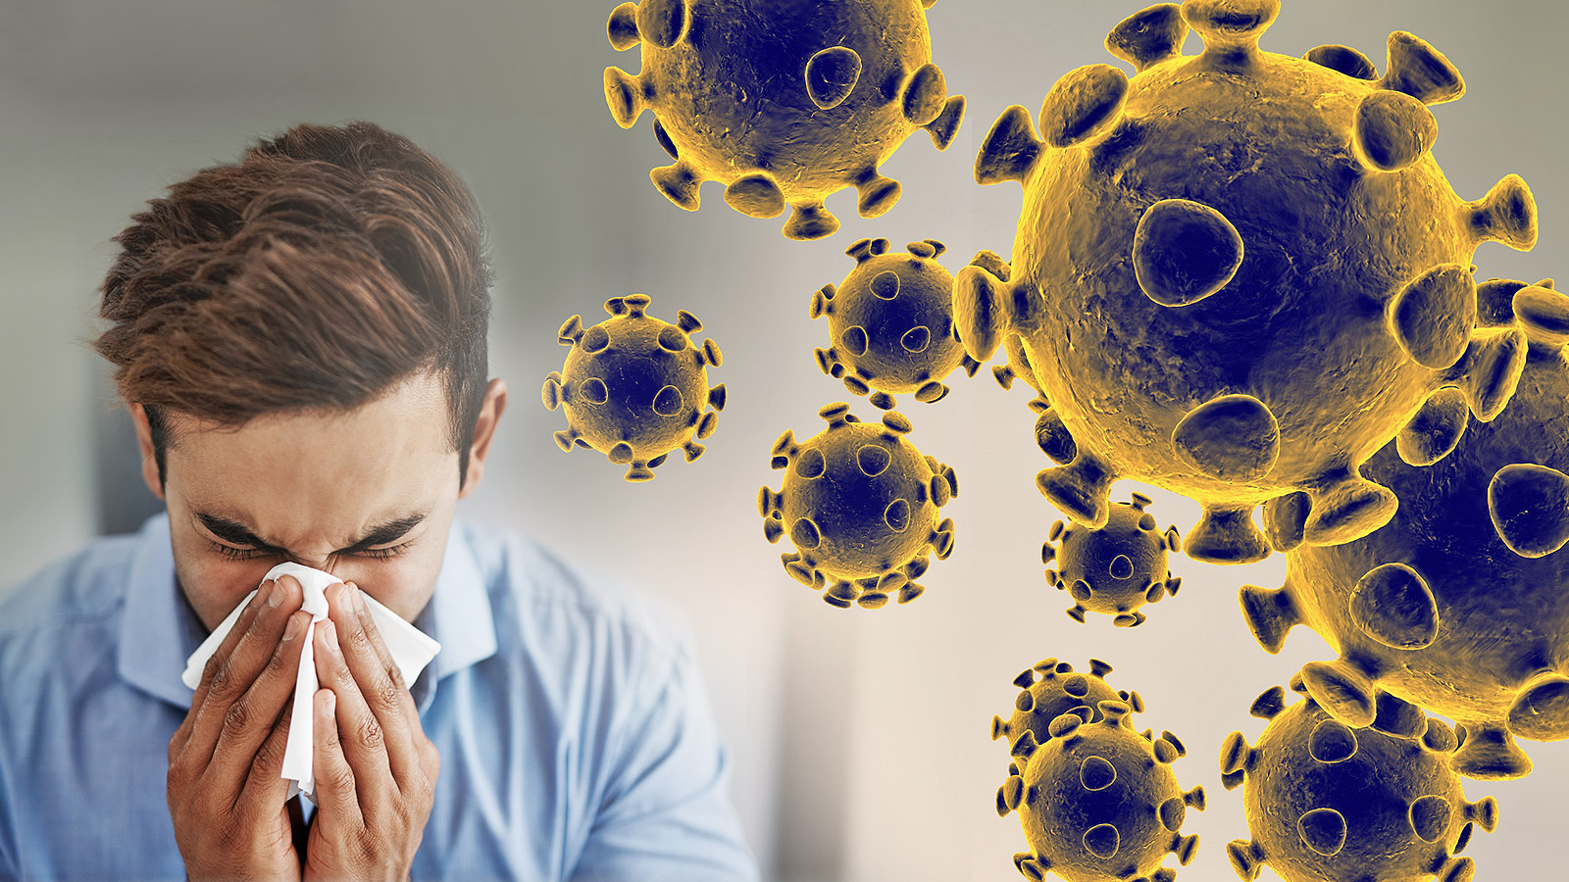
Idea
Stop the transmission by prioritizing tests and hence detecting the cases quickly.
Data can be collected on the symptoms of COVID-19.
A machine learning model is then trained on the data to find out the probability of a person having the infection.
The model is then used to find out whom to test for the infection first under a limited testing capacity.
The same model can be used to find potential candidate for conducting random tests.

Slide 3
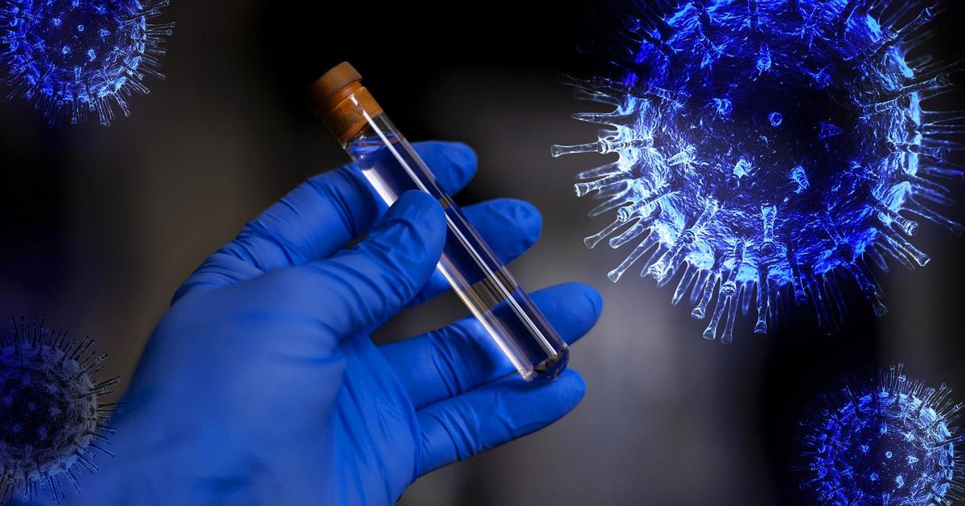
Machine Learning model parameters:-
A team of doctors can sit down to find out the best model parameters.
A sample set of parameters is as follow:
Features:
Average Fever-Contineous
Body Pain-0/1 Binary
Age-Discrete
Runny Nose
Breathing Problem- Categorical: 0/1/-1
Labels:
Probability of COVID-19 Infection

Slide 4
TOOLS AND LIBRARIES :
1. VS Code
2. Bootstrap
3. Python (Flask ,Pandas, Numpy)
4. HTML
5.CSS
6.Machine Learning( scikit-learn and LogisticRegression)

Slide 5
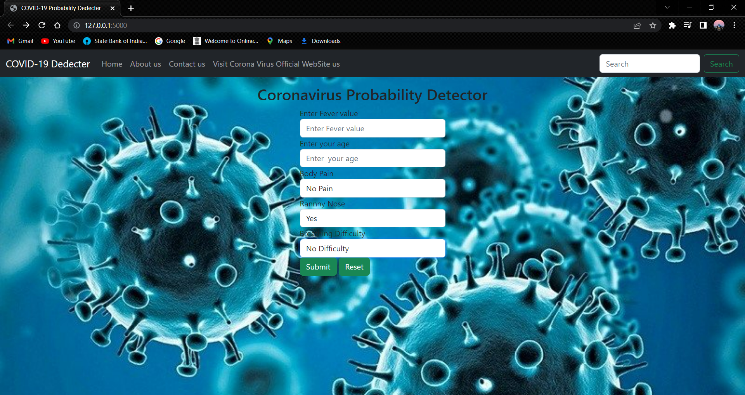

Slide 6
Folder Structure of the project
1. Index.html: Contains the HTML we will create a UI with a form the would be show on the page.
2. data.CSV: Data to be randomly generated for this prototype.
3.main.py: contains python library flask code. There are several functions that work together to handle all the function of the projects.
4.myTraining.py: using sklearn and LogisticRegression capable of storing inferring the input data from the trained model.
Example: First of all my user interface will ask the patient his fever, age, body pain, runnyose and breathing difficulty after that the detector will tell how much probability are there to be covid infected.

Slide 7


Slide 8
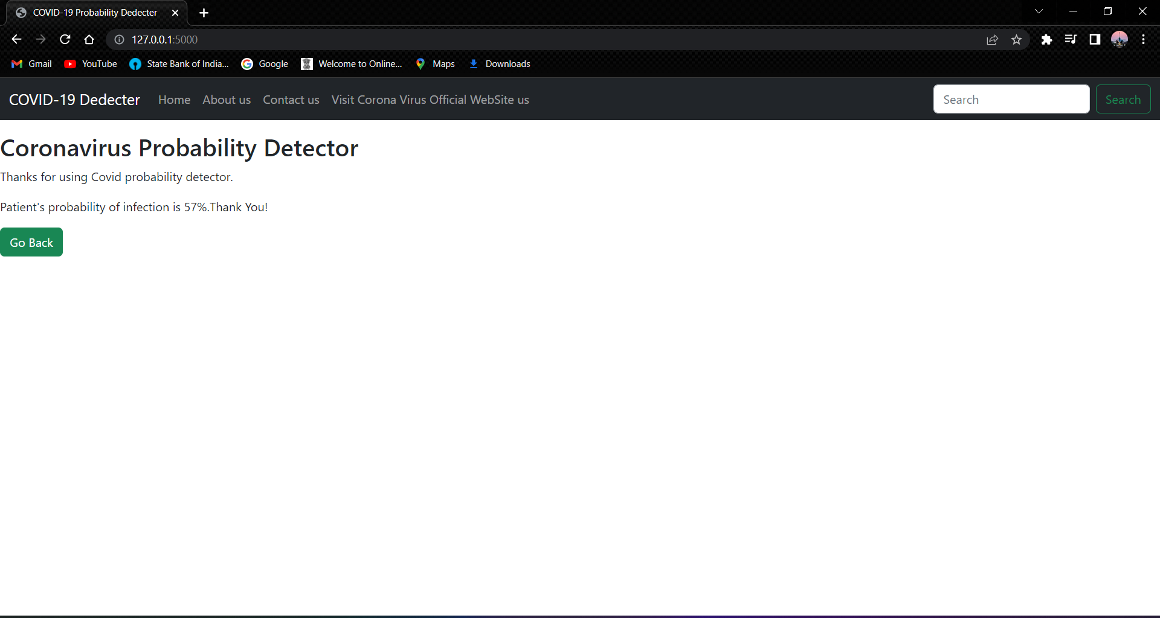

Slide 9
Github ID
https://github.com/rajak88953

Slide 10
THANK YOU

